Slide 1
Parents360
Synthetic Drugs: Bath Salts, K2/Spice
Notes:
Hello, and welcome to the Parents360 module that addresses issues pertaining to synthetic drugs such as Bath Salts and K2/Spice.
Some background to start:“Parents360 – Parents: You Matter” is a community education presentation that helps parents and other adults who care about kids learn how to communicate effectively with their children, look out for them and get them help if and when they need it. The presentation has a number of drug-specific modules that can be added to it. The one we’re talking about today is Synthetic Drugs such as Bath Salts and K2/Spice.
This is a very important topic to address because synthetic drugs are dangerous. They are not ‘safe' as a second choice, or as an alternative to more well-known drugs, for your kids, and you must communicate that fact with them. This presentation will help provide you with the information and resources to have that discussion.

Slide 2
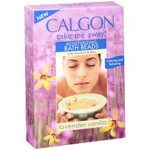
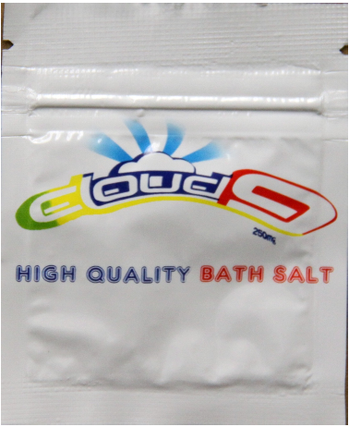
“Bath Salts” are not Bath Salts
≠
Notes:
The first thing that parents should know is that the drug called Bath Salts is very different from the product that you put into a bath. The only reason why they have the same name is because the products look similar.

Slide 3
What are “Bath Salts?”
Stimulants: Manmade chemicals related to amphetamines (speed)
Substituted cathinones -- Methylenedioxypyrovalerone (MDPV) and mephedrone, and methylone are the chemicals most often found in “bath salts”
Consumed orally or nasally
Drug Enforcement Administration
Notes:
So – what are Bath Salts anyway? They are a man-made, chemical (as opposed to organic) stimulant drug. Generally, stimulants are a class of drugs that elevate mood, increase feelings of well-being and increase energy and alertness. Amphetamines, or speed, are an example of stimulant drugs.
The technical term for Bath Salts is “substituted cathinone.” Now, what does that mean? You may have heard of Khat, a plant that is cultivated and used in East Africa and the Middle East. It has a stimulant effect on the user and can be quite dangerous. Substituted cathinones are synthetic, concentrated versions of the stimulant chemical in Khat. Methylenedioxypyrovalerone (MDPV), mephedrone and methylone are the chemicals most often found in “Bath Salts.”
They can be ingested orally or snorted through the nose.
So – what are Bath Salts anyway? They are a man-made, chemical (as opposed to organic) – stimulant drug. Generally, stimulants are a class of drugs that elevate mood, increase feelings of well-being and increase energy and alertness. Amphetamines, or speed, are an example of stimulant drugs.
The technical term for “Bath Salts” is “substituted cathinone.” Now, what does that mean? You may have heard of Khat, a plant that is cultivated and used in East Africa and the Middle East. It has a stimulant effect on the user and can be quite dangerous. Substituted cathinones are synthetic, concentrated versions of the stimulant chemical in Khat. Methylenedioxypyrovalerone (MDPV), mephedrone and methylone are the chemicals most often found in “bath salts.”
They can be ingested orally or snorted through the nose.

Slide 4
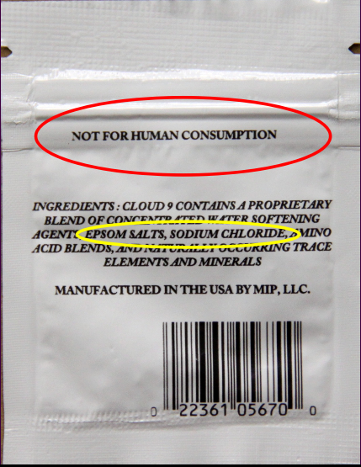
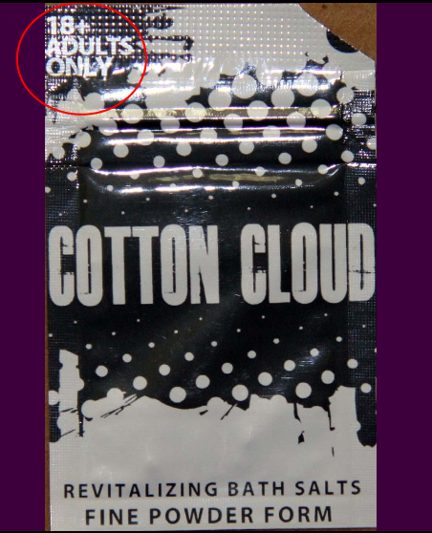
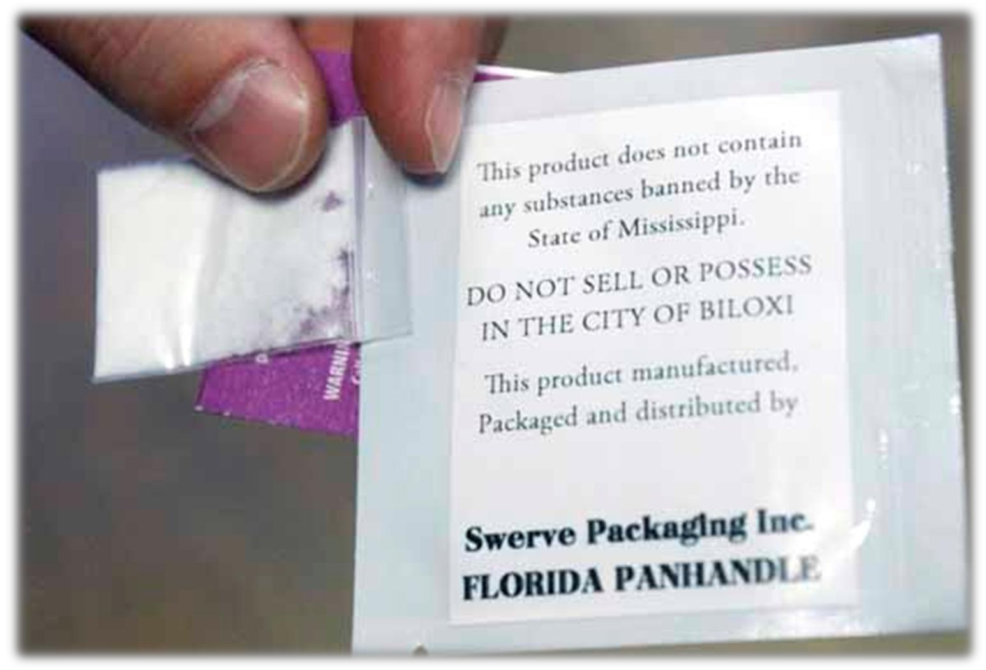
How can you tell?
If it says it is “Not For Human Consumption”
Or it is not illegal
Or it is only for 18+ Adults Only
It is probably for ingestion, not a hot bath
Notes:
So – how can you tell if something that is labeled as a bath salt is really a drug?
Well, first off, if it is contained in a packet that is about the size of a moist towelette, it probably isn’t designed for use in a bathtub that can hold anywhere from 30 to 60 gallons of water.
But if it also says, “not for human consumption,” says that it is “not illegal” (never a good sign) or that it is for “adults only,” it is probably a drug that was created for ingestion and not for a hot bath.

Slide 5
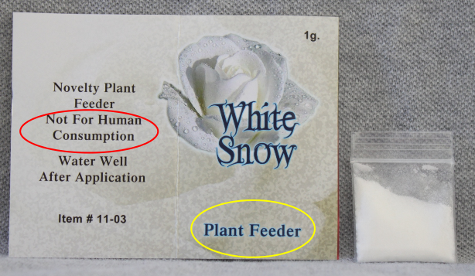
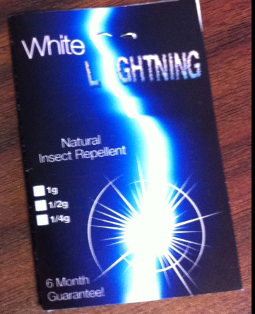
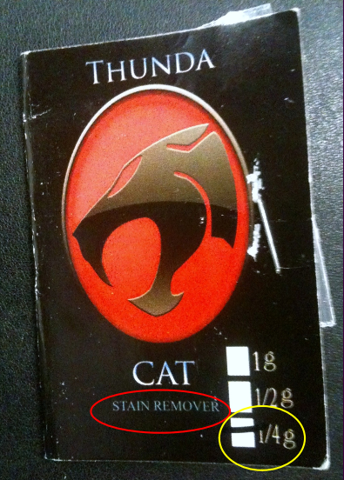
Many Brands and Names and Not Always Sold as Bath Salts
Plant Feeder
Insect Repellent
Stain Remover
Notes:
What makes this even trickier is that not all “Bath Salts” are marketed as Bath Salts.
Substituted cathinones and related drugs have been sold as plant feeder, insect repellent and even stain remover.
It is also important to note that there is no standard formulation for these drugs. The composition of chemicals that is sold in one packet may be completely different than what is sold in an identical packet.
So – why all of the mystery?
It is because when these drugs were legal, the people trying to sell them were working to exploit very specific loopholes in the law. For a period of time, these drugs were not illegal because the law did not include them. That has changed, and we will talk about that in a moment. But once word went out that Bath Salts were dangerous, the distributors of these drugs put them in new, deceiving packages.

Slide 6
Why Do Teens Use “Bath Salts”?
For energy / alternative to illegal stimulants
Perceived to be legal
Not picked up on standard drug tests
Available at retail outlets: convenience stores; head shops; online
Notes:
So why would a teen or young adult, or anyone for that matter, make a decision to use “Bath Salts?”
First, we’ll look at some of the same reasons why people use stimulants. For some, it is to get high or escape, but for many others it is to get energy or endurance to make it through the day. Many people – not just teens – feel overworked and overstressed, and in those situations, a stimulant can have a lot of appeal.
Peer pressure or curiosity can play a large role, and often teens don’t know what the effects will be until it’s too late. Word of mouth can also play a big part in deciding to try it.
Anecdotally, potential users may think that Bath Salts are safer than methamphetamine. They may perceive them to be legal. They may think that they would not test positive – at work or at school – if they use it.
And these drugs are readily available – if you walk into some convenience stores or gas stations, you may see a whole display of pills and packages marked as “vitamins” or “energy boosters.” Some may be legal, and some may not be. Head shops – which are in the business of selling drug paraphernalia just within the limits of the law – may sell these drugs, and a search for Bath Salts online yields more than 1.3 million results.

Slide 7
Effects of “Bath Salts”
Very severe paranoia that sometimes causes users to harm themselves or others.
Speed of onset – 15 minutes; Length of high – 4-6 hours
Long term effects: Unknown
Effects reported to Poison Control Centers
Suicidal thoughts
Agitation; Combative/Violent; Confusion
Hallucinations / psychosis
Increased heart rate; Hypertension; Chest Pain
Death or serious injury
Source: American Association of Poison Control Centers
Notes:
The effects of Bath Salts can be severe.
Very severe paranoia can sometimes cause users to harm themselves or others. Effects reported to Poison Control Centers include:
Suicidal thoughts
Agitation
Combative/Violent behavior
Confusion
Hallucinations/psychosis
Increased heart rate
Hypertension
Chest Pain
Death or serious injury
The speed of onset is 15 minutes, while the length of the high from these drugs is 4-6 hours.
It is especially troubling that the long-term effects of the drug are unknown, because the drug has only been used widely within the past decade. We don’t know what the future will hold or exactly how people will be affected.

Slide 8
Calls To Poison Control Centers for Human Exposure to Bath Salts, 2010 to January 2012
In early 2011, calls closed in each month* spiked through June, then gradually declined and is level in the past 3 months.
The number of calls closed in 2011 are over 20 times that in 2010.
Projection based on
preliminary January data
2011
2012
*Numbers may change as cases are closed and additional information is received.
Source: American Association of Poison Control Centers, Bath Salts Data, Updated February 8, 2012 (Preliminary data).
2/2012
Notes:
Poison centers first raised the alarm about Bath Salts in December 2010 after they started receiving calls about people having serious reactions to the chemicals, such as increased blood pressure and heart rate, agitation, hallucinations, extreme paranoia and delusions. In 2010, poison centers received 304 calls about exposures to Bath Salts. That number rose dramatically in 2011 when poison centers received 6,138 calls. In early 2011, calls closed in each month spiked through June, then gradually declined and was level in November and December 2011 and January 2012. While this is notable progress, projections based on January 2012 data indicate that use will remain far above 2010 levels in 2012.

Slide 9
Synthetic Marijuana, K2 / “Spice”
Notes:
We now make the move from salts to Spice –

Slide 10
Synthetic Marijuana
K2 or "Spice" are common names for synthetic marijuana, however, the effects of synthetic marijuana can be very different from cultivated marijuana
K2 or "Spice" is a mixture of herbs or dried, shredded plant material that is typically sprayed with chemicals that are similar to THC, the psychoactive ingredients in marijuana
Street names: Bliss, Black Mamba, Bombay Blue, Blaze, Genie, Spice, Zohai, JWH -018, -073, -250
Notes:
“K2” and “Spice” are street names for synthetic marijuana. Whatever perceptions people have of marijuana, they should not underestimate the risk of this drug or make the mistake that synthetic marijuana is somehow less dangerous than cultivated marijuana.
K2 or Spice is a mixture of herbs or other plant materials that have been sprayed with artificial chemicals that are supposed to mimic the effects of THC, the psychoactive ingredient in marijuana. One group of these artificial chemicals has the prefix “JWH,” so you will see JWH-018, JWH-073 and others. It is important to note that K2/Spice is completely synthetic, so while these drugs may act on the same parts of the brain and body as THC, the effects can be very different.
In addition to the most common names, K2 and Spice, this product is sold under a number of trade names such as “Blaze,” “Bliss,” “Black Mamba,” “Bombay Blue,” “Genie” or by the names of the chemicals that are used in the production process such as JWH-018.

Slide 11
Signs of Use
Strong clove smell
Coffee grinder – finer the powder, easier to smoke
Drug paraphernalia (pipes, screens, etc.)
Typically smoked
Notes:
One of the signs that parents can look for is a strong clove smell. K2/Spice is typically smoked, so parents may find a coffee grinder around the house – which is often used to reduce the product to a fine powder so that it is easier to smoke – and other drug paraphernalia such as pipes or screens.

Slide 12
Physical Signs of Use
Loss of control
Lack of pain response
Increased agitation
Pale skin
Seizures
Vomiting
Profuse sweating
Uncontrolled / spastic body movements
Elevated blood pressure, heart rate, and palpitations
Source: Prosecuting Attorneys Association of Michigan
Notes:
The physical signs of use are very troubling.
You may notice increased agitation, profuse sweating, pale skin or vomiting.
But what may be of the greatest concern is the loss of physical control – a kind of brain-body disconnect. This is where you may see seizures, a lack of pain response or uncontrolled/spastic body movements.

Slide 13
Effects of Synthetic Marijuana
Onset – 3-5 minutes
Length of duration – 1-8 hours
Short-term effects: In addition to physical signs of use, users may experience:
Dysphoria – the opposite of euphoria
Paranoia – similar to PCP / Angel Dust
Delusions, hallucinations and increased agitation
Long-term effects: Unknown
Source: Prosecuting Attorneys Association of Michigan
Notes:
Looking at the effects another way, parents should know that the onset of this drug is fairly quick, and – depending on a number of factors – the length of the high can last from one to eight hours.
The paranoia that is associated with K2/Spice is closer to the psychological reaction to PCP or angel dust than to the paranoia associated with marijuana.
One of the most frightening factors is that users may experience dysphoria. The best way to explain dysphoria is that it is the opposite of euphoria. A spice user posted a blog comment that read in part, “I felt as if I was in hell – this morbid place that I couldn’t get out of.” (http://cenblog.org/terra-sigillata/2010/09/07/whats-the-buzz-synthetic-marijuana-k2-spice-jwh-018/)
As troubling as the short-term effects of this drug are, what is even more concerning is the fact that no one knows what their long-term effects will be. They simply haven’t been around long enough for medical professionals to know how users will be affected in 10 years, 20 years or even further in the future.

Slide 14
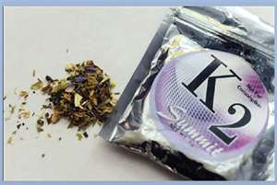
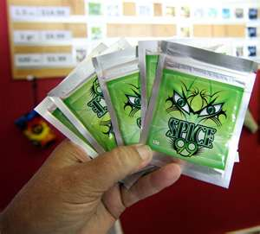
How is K2 obtained?
K2 is typically sold in small, silvery plastic bags of dried leaves and marketed as incense that can be smoked. It is said to resemble potpourri
K2 is sold online, in convenience stores and in “head” shops, and is usually marketed as incense
Notes:
Like Bath Salts, K2/Spice is sold online, in convenience stores and in “head” shops. It is often marketed as incense.

Slide 15
K2 / Spice Use
Source: Monitoring the Future, 2011, Past-Year Use, 12th Graders only
Notes:
While these drugs may be “news” to many parents, more than one in 10 American high school seniors used synthetic marijuana in the prior year according to the “Monitoring the Future” study, a survey conducted by the University of Michigan,.
At 11.4 percent, the annual prevalence of synthetic marijuana is:
41 percent greater than Vicodin (8.1 percent)
Four times greater than inhalants (3.2 percent)
Four times greater than cocaine (2.9 percent)
Eight times greater than meth (1.4 percent)
It is also more common than hallucinogens, LSD and OxyContin and twice as likely to be used as over-the-counter cough/cold medicine.

Slide 16
Calls Received by Poison Control Centers for Human Exposure to Synthetic Marijuana, 2010 to January 2012
Projection based on
preliminary January data
2011
2012
Source: American Association of Poison Control Centers, Synthetic Marijuana Data, Updated February 8, 2012 (Preliminary data)
2/2012
Notes:
Calls to poison control centers for exposure to synthetic marijuana doubled between 2010 and 2011 and is on track to rise again in 2012.

Slide 17
DEA takes action
On November 24, 2010, the Drug Enforcement Administration (DEA) took emergency action to temporarily control five chemicals used to make K2 and other “fake pot” products.
On September 7, 2011, the DEA banned three of the drugs found in bath salts
Possessing and selling these chemicals or the products that contain is now illegal in the U.S.
The DEA will study these chemicals to determine if these products should be permanently controlled.
Congress is also working to act on this issue.
Regulators face the challenge of staying ahead of formulations
Notes:
In the past two years, the Drug Enforcement Administration has taken emergency action to make both Bath Salts and K2/Spice illegal. There is now a study period taking place to determine if these bans will remain permanent.
The challenge for regulators and parents, however, is to stay ahead of the new formulas and versions of these drugs that may not be covered by current law.
Congress is also working to act on this issue.
However, regulators and parents face the challenge of staying ahead of new formulations.

Slide 18
Messages Parents Can Deliver
It is impossible to know what these drugs contain, or who made them, or what you are going to get
Getting high – no matter how – carries risks of making unsafe or unhealthy decisions
Just because a drug is legal – or is labeled as legal – does not mean that it is safe
We don’t know the long term effects of synthetic drugs because the drugs are so new
Notes:
So what can parents and other influencers say to young people about the dangers of these drugs?
A good overarching message to kids is to avoid putting anything in their bodies that would change their feelings or emotions – whether it is something they would smoke, drink, take in pill form or shoot with a needle. The human brain is an incredible machine, and you need to be even more careful with a teenage brain because it is a work in progress.
Additional messages include:
It is impossible to know what these drugs contain, who made them or what you are going to get.
Getting high – no matter how – carries risks of making unsafe or unhealthy decisions.
Just because a drug is legal – or is labeled as legal – does not mean that it is safe.
We don’t know the long-term effects of synthetic drugs because the drugs are so new.

Slide 19
Drugfree.org Resources
PREVENT
TimeToTalk helps you start the conversation
Habla Con Tus Hijos-Spanish-language version
The Decoder blog
The Drug Guide for Parents
INTERVENE
Time to Act if you think or know your child is using.
Intervene blog
Intervention eBook
GET TREATMENT
Treatment eBook
Time to Get Help helps parents better understand teen and young adult substance abuse and addiction.
RECOVER
Time to Get Help community connects parents who understand and have been there.
You are not alone
Notes:
The Partnership at Drugfree.org’s “Time To Talk” resource, found at TimeToTalk.org, offers easy-to-use, research-based tips to help you have ongoing conversations with your kids to keep them healthy and drug free.
HablaConTusHijos.org is the Spanish-language version of Time to Talk.
The Decoder blog addresses real issues that real parents face every day.
The Drug Guide for Parents shares facts about the top 13 drugs most commonly abused by teens.
Time to Act! provides parents with step-by-step guidance on what to do if they think or know that their child is using.
The Intervene blog is a forum for experts, parents and caring adults to share their experiences and insights.
The Intervention eBook provides parents with an additional way to learn about how to help their child.
The Treatment eBook provides parents with a guide to understanding what treatment is, how to pay for it, how to start treatment and more.
Time to Get Help gives parents a better understanding of teen and young adult substance abuse and addiction and a community to share their experiences and support one another.
A key message that we want to deliver to parents and other people who care about kids is that whether you are working to prevent use by their child, responding to it or supporting your child’s recovery, you are not alone.

Slide 20
Connect with The Partnership at Drugfree.org
HELPLINE
1- 855 -DRUGFREE
FACEBOOK
/partnershipdrugfree
eNewsletter
News & tips in your inbox.
TWITTER
@drugnews
Drugfree.org/eNewsletters
Notes:
We want families to connect with the Partnership.
The Partnership at Drugfree.org’s Parents Toll-Free Helpline offers assistance to parents who want to talk to someone about their child’s drug use and drinking.
Our Helpline is open Monday through Friday from 10:00 am to 6:00 pm ET. We are closed on weekends and holidays. The Helpline is not a crisis line. If you do not connect with a parent specialist, please leave a message and we will make every effort to get back to you by the next business day. If you are in need of immediate or emergency services please call 911 or a 24-hour crisis hotline.
Our eNewsletters are a great way to get updated information about substance abuse and actions parents can take to help their kids delivered directly to your inbox.
You can friend us on Facebook, or you can follow our Twitter feed.
We try to provide as many ways as possible to for you to keep in touch with us!

Slide 21
PARENTS360 Thank You!
Notes:
21
In the coming months, we will be creating additional slidecasts that use content from the Parents360 presentation and modules.
If you would like to be notified when these screencasts are published, please be sure to sign up for the Community Education newsletter at drugfree.org, or “like” The Partnership at Drugfree.org on Facebook.
Thank you for your time, your attention and for your concern for the young people in your life.

Slide 22
Acknowledgement
This project was supported by Grant No. 2010- DB-BX-K025 awarded by the Bureau of Justice Assistance. The Bureau of Justice Assistance is a component of the Office of Justice Programs, which also includes the Bureau of Justice Statistics, the National Institute of Justice, the Office of Juvenile Justice and Delinquency Prevention, the Office for Victims of Crime, and the Office of Sex Offender Sentencing, Monitoring, Apprehending, Registering, and Tracking. Points of view or opinions in this document are those of the author and do not necessarily represent the official position or policies of the U.S. Department of Justice.

